Slide 1
Introduction to Artificial Intelligence
CSE 317: Artificial Intelligence

Slide 2
Reference Book
Artificial Intelligence: A Modern Approach
Stuart Russell and Peter Norving

Slide 3
Goals of this Course
This class is a broad introduction to artificial intelligence (AI)
AI is a very broad field with many subareas
We will cover many of the primary concepts/ideas

Slide 4
Why AI can change our life…..
As we begin the new millenium
science and technology are changing rapidly
“old” sciences such as physics are relatively well-understood
computers are ubiquitous
Grand Challenges in Science and Technology
understanding the brain
reasoning, cognition, creativity
creating intelligent machines
is this possible?
what are the technical and philosophical challenges?
arguably AI poses the most interesting challenges and questions in computer science today

Slide 5
This Lecture
What is intelligence? What is artificial intelligence?
A very brief history of AI
Modern successes: Stanley the driving robot
An AI scorecard
How much progress has been made in different aspects of AI
AI in practice
Successful applications
The rational agent view of AI

Slide 6
What is Intelligence?
Intelligence:
“the capacity to learn and solve problems” (Websters dictionary)
in particular,
the ability to solve novel problems
the ability to act rationally
the ability to act like humans
Artificial Intelligence
build and understand intelligent entities or agents
2 main approaches: “engineering” versus “cognitive modeling”

Slide 7
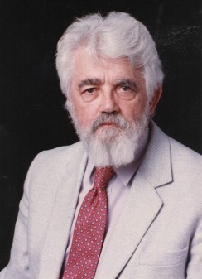
What is Artificial Intelligence? (John McCarthy, Stanford University)
What is artificial intelligence?
It is the science and engineering of making intelligent machines, especially intelligent computer programs. It is related to the similar task of using computers to understand human intelligence, but AI does not have to confine itself to methods that are biologically observable.
Yes, but what is intelligence?
Intelligence is the computational part of the ability to achieve goals in the world. Varying kinds and degrees of intelligence occur in people, many animals and some machines.
Isn't there a solid definition of intelligence that doesn't depend on relating it to human intelligence?
Not yet. The problem is that we cannot yet characterize in general what kinds of computational procedures we want to call intelligent. We understand some of the mechanisms of intelligence and not others.
More in: http://www-formal.stanford.edu/jmc/whatisai/node1.html

Slide 8
What’s involved in Intelligence?
Ability to interact with the real world
to perceive, understand, and act
e.g., speech recognition and understanding and synthesis
e.g., image understanding
e.g., ability to take actions, have an effect
Reasoning and Planning
modeling the external world, given input
solving new problems, planning, and making decisions
ability to deal with unexpected problems, uncertainties
Learning and Adaptation
we are continuously learning and adapting
our internal models are always being “updated”
e.g., a baby learning to categorize and recognize animals

Slide 9
Academic Disciplines relevant to AI
Philosophy Logic, methods of reasoning, mind as physical system, foundations of learning, language, rationality.
Mathematics Formal representation and proof, algorithms, computation, (un)decidability, (in)tractability
Probability/Statistics modeling uncertainty, learning from data
Economics utility, decision theory, rational economic agents
Neuroscience neurons as information processing units.
Psychology/ how do people behave, perceive, process cognitive
Cognitive Science information, represent knowledge.
Computer building fast computers engineering
Control theory design systems that maximize an objective function over time
Linguistics knowledge representation, grammars

Slide 10
History of AI
1943: early beginnings
McCulloch & Pitts: Boolean circuit model of brain
1950: Turing
Turing's "Computing Machinery and Intelligence“
1956: birth of AI
Dartmouth meeting: "Artificial Intelligence“ name adopted
1950s: initial promise
Early AI programs, including
Samuel's checkers program
Newell & Simon's Logic Theorist
1955-65: “great enthusiasm”
Newell and Simon: GPS, general problem solver
Gelertner: Geometry Theorem Prover
McCarthy: invention of LISP

Slide 11
History of AI
1966—73: Reality dawns
Realization that many AI problems are intractable
Limitations of existing neural network methods identified
Neural network research almost disappears
1969—85: Adding domain knowledge
Development of knowledge-based systems
Success of rule-based expert systems,
E.g., DENDRAL, MYCIN
But were brittle and did not scale well in practice
1986-- Rise of machine learning
Neural networks return to popularity
Major advances in machine learning algorithms and applications
1990-- Role of uncertainty
Bayesian networks as a knowledge representation framework
1995-- AI as Science
Integration of learning, reasoning, knowledge representation
AI methods used in vision, language, data mining, etc

Slide 12
Success Stories
Deep Blue defeated the reigning world chess champion Garry Kasparov in 1997
AI program proved a mathematical conjecture (Robbins conjecture) unsolved for decades
During the 1991 Gulf War, US forces deployed an AI logistics planning and scheduling program that involved up to 50,000 vehicles, cargo, and people
NASA's on-board autonomous planning program controlled the scheduling of operations for a spacecraft
Proverb solves crossword puzzles better than most humans
Robot driving: DARPA grand challenge 2003-2007
2006: face recognition software available in consumer cameras

Slide 13
Example: DARPA Grand Challenge
Grand Challenge
Cash prizes ($1 to $2 million) offered to first robots to complete a long course completely unassisted
Stimulates research in vision, robotics, planning, machine learning, reasoning, etc
2004 Grand Challenge:
150 mile route in Nevada desert
Furthest any robot went was about 7 miles
… but hardest terrain was at the beginning of the course
2005 Grand Challenge:
132 mile race
Narrow tunnels, winding mountain passes, etc
Stanford 1st, CMU 2nd, both finished in about 6 hours
2007 Urban Grand Challenge
This November in Victorville, California

Slide 14
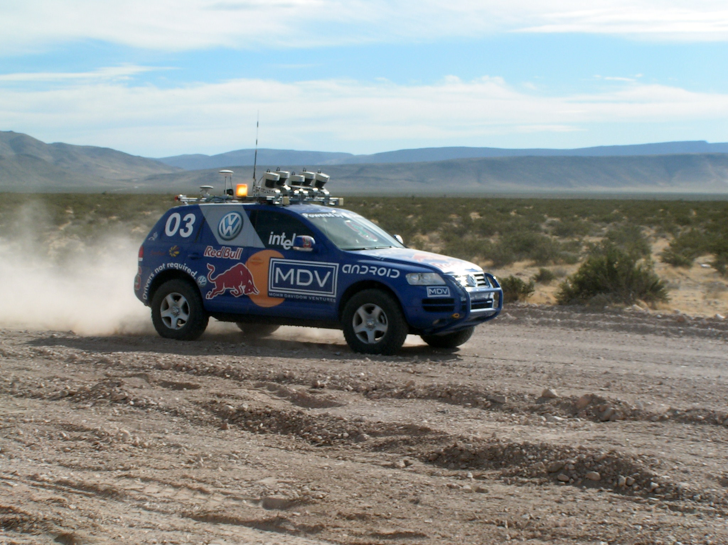
Stanley Robot
Stanford Racing Team www.stanfordracing.org
Next few slides courtesy of Prof.
Sebastian Thrun, Stanford University

Slide 15




2004: Barstow, CA, to Primm, NV
150 mile off-road robot race across the Mojave desert
Natural and manmade hazards
No driver, no remote control
No dynamic passing
Fastest vehicle wins the race (and 2 million dollar prize)

Slide 16

The Grand Challenge Race

Slide 17
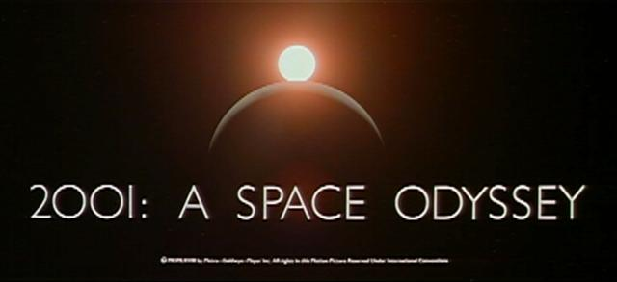
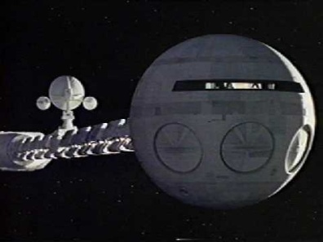
HAL: from the movie 2001
2001: A Space Odyssey
classic science fiction movie from 1969
HAL
part of the story centers around an intelligent computer called HAL
HAL is the “brains” of an intelligent spaceship
in the movie, HAL can
speak easily with the crew
see and understand the emotions of the crew
navigate the ship automatically
diagnose on-board problems
make life-and-death decisions
display emotions
In 1969 this was science fiction: is it still science fiction?

Slide 18
Hal and AI
HAL’s Legacy: 2001’s Computer as Dream and Reality
MIT Press, 1997, David Stork (ed.)
discusses
HAL as an intelligent computer
are the predictions for HAL realizable with AI today?
Materials online at
http://mitpress.mit.edu/e-books/Hal/contents.html
The website contains
full text and abstracts of chapters from the book
links to related material and AI information
sound and images from the film

Slide 19
Consider what might be involved in building a computer like Hal….
What are the components that might be useful?
Fast hardware?
Chess-playing at grandmaster level?
Speech interaction?
speech synthesis
speech recognition
speech understanding
Image recognition and understanding ?
Learning?
Planning and decision-making?

Slide 20
Can we build hardware as complex as the brain?
How complicated is our brain?
a neuron, or nerve cell, is the basic information processing unit
estimated to be on the order of 10¹² neurons in a human brain
many more synapses (10 ¹⁴) connecting these neurons
cycle time: 10 ⁻³ seconds (1 millisecond)
How complex can we make computers?
10⁸ or more transistors per CPU
supercomputer: hundreds of CPUs, 10¹² bits of RAM
cycle times: order of 10 ⁻ ⁹ seconds
Conclusion
YES: in the near future we can have computers with as many basic processing elements as our brain, but with
far fewer interconnections (wires or synapses) than the brain
much faster updates than the brain
but building hardware is very different from making a computer behave like a brain!

Slide 21
Can Computers beat Humans at Chess?
Chess Playing is a classic AI problem
well-defined problem
very complex: difficult for humans to play well
Conclusion:
YES: today’s computers can beat even the best human
Deep Blue
Human World Champion
Deep Thought
Points Ratings

Slide 22
Can Computers Talk?
This is known as “speech synthesis”
translate text to phonetic form
e.g., “fictitious” -> fik-tish-es
use pronunciation rules to map phonemes to actual sound
e.g., “tish” -> sequence of basic audio sounds
Difficulties
sounds made by this “lookup” approach sound unnatural
sounds are not independent
e.g., “act” and “action”
modern systems (e.g., at AT&T) can handle this pretty well
a harder problem is emphasis, emotion, etc
humans understand what they are saying
machines don’t: so they sound unnatural
Conclusion:
NO, for complete sentences
YES, for individual words

Slide 23
Can Computers Recognize Speech?
Speech Recognition:
mapping sounds from a microphone into a list of words
classic problem in AI, very difficult
“Lets talk about how to wreck a nice beach”
(I really said “________________________”)
Recognizing single words from a small vocabulary
systems can do this with high accuracy (order of 99%)
e.g., directory inquiries
limited vocabulary (area codes, city names)
computer tries to recognize you first, if unsuccessful hands you over to a human operator
saves millions of dollars a year for the phone companies

Slide 24
Recognizing human speech (ctd.)
Recognizing normal speech is much more difficult
speech is continuous: where are the boundaries between words?
e.g., “John’s car has a flat tire”
large vocabularies
can be many thousands of possible words
we can use context to help figure out what someone said
e.g., hypothesize and test
try telling a waiter in a restaurant: “I would like some dream and sugar in my coffee”
background noise, other speakers, accents, colds, etc
on normal speech, modern systems are only about 60-70% accurate
Conclusion:
NO, normal speech is too complex to accurately recognize
YES, for restricted problems (small vocabulary, single speaker)

Slide 25
Can Computers Understand speech?
Understanding is different to recognition:
“Time flies like an arrow”
assume the computer can recognize all the words
how many different interpretations are there?

Slide 26
Can Computers Understand speech?
Understanding is different to recognition:
“Time flies like an arrow”
assume the computer can recognize all the words
how many different interpretations are there?
1. time passes quickly like an arrow?
2. command: time the flies the way an arrow times the flies
3. command: only time those flies which are like an arrow
4. “time-flies” are fond of arrows

Slide 27
Can Computers Understand speech?
Understanding is different to recognition:
“Time flies like an arrow”
assume the computer can recognize all the words
how many different interpretations are there?
1. time passes quickly like an arrow?
2. command: time the flies the way an arrow times the flies
3. command: only time those flies which are like an arrow
4. “time-flies” are fond of arrows
only 1. makes any sense,
but how could a computer figure this out?
clearly humans use a lot of implicit commonsense knowledge in communication
Conclusion: NO, much of what we say is beyond the capabilities of a computer to understand at present

Slide 28
Can Computers Learn and Adapt ?
Learning and Adaptation
consider a computer learning to drive on the freeway
we could teach it lots of rules about what to do
or we could let it drive and steer it back on course when it heads for the embankment
systems like this are under development (e.g., Daimler Benz)
e.g., RALPH at CMU
in mid 90’s it drove 98% of the way from Pittsburgh to San Diego without any human assistance
machine learning allows computers to learn to do things without explicit programming
many successful applications:
requires some “set-up”: does not mean your PC can learn to forecast the stock market or become a brain surgeon
Conclusion: YES, computers can learn and adapt, when presented with information in the appropriate way

Slide 29
Can Computers “see”?
Recognition v. Understanding (like Speech)
Recognition and Understanding of Objects in a scene
look around this room
you can effortlessly recognize objects
human brain can map 2d visual image to 3d “map”
Why is visual recognition a hard problem?
Conclusion:
mostly NO: computers can only “see” certain types of objects under limited circumstances
YES for certain constrained problems (e.g., face recognition)

Slide 30
Can computers plan and make optimal decisions?
Intelligence
involves solving problems and making decisions and plans
e.g., you want to take a holiday in Brazil
you need to decide on dates, flights
you need to get to the airport, etc
involves a sequence of decisions, plans, and actions
What makes planning hard?
the world is not predictable:
your flight is canceled or there’s a backup on the 405
there are a potentially huge number of details
do you consider all flights? all dates?
no: commonsense constrains your solutions
AI systems are only successful in constrained planning problems
Conclusion: NO, real-world planning and decision-making is still beyond the capabilities of modern computers
exception: very well-defined, constrained problems

Slide 31
Summary of State of AI Systems in Practice
Speech synthesis, recognition and understanding
very useful for limited vocabulary applications
unconstrained speech understanding is still too hard
Computer vision
works for constrained problems (hand-written zip-codes)
understanding real-world, natural scenes is still too hard
Learning
adaptive systems are used in many applications: have their limits
Planning and Reasoning
only works for constrained problems: e.g., chess
real-world is too complex for general systems
Overall:
many components of intelligent systems are “doable”
there are many interesting research problems remaining

Slide 32
Intelligent Systems in Your Everyday Life
Post Office
automatic address recognition and sorting of mail
Banks
automatic check readers, signature verification systems
automated loan application classification
Customer Service
automatic voice recognition
The Web
Identifying your age, gender, location, from your Web surfing
Automated fraud detection
Digital Cameras
Automated face detection and focusing
Computer Games
Intelligent characters/agents

Slide 33
AI Applications: Machine Translation
Language problems in international business
e.g., at a meeting of Japanese, Korean, Vietnamese and Swedish investors, no common language
or: you are shipping your software manuals to 127 countries
solution; hire translators to translate
would be much cheaper if a machine could do this
How hard is automated translation
very difficult! e.g., English to Russian
“The spirit is willing but the flesh is weak” (English)
“the vodka is good but the meat is rotten” (Russian)
not only must the words be translated, but their meaning also!
is this problem “AI-complete”?
Nonetheless....
commercial systems can do a lot of the work very well (e.g.,restricted vocabularies in software documentation)
algorithms which combine dictionaries, grammar models, etc.
Recent progress using “black-box” machine learning techniques

Slide 34

AI and Web Search

Slide 35
What’s involved in Intelligence? (again)
Perceiving, recognizing, understanding the real world
Reasoning and planning about the external world
Learning and adaptation
So what general principles should we use to achieve these goals?

Slide 36
Different Types of Artificial Intelligence
Modeling exactly how humans actually think
Modeling exactly how humans actually act
Modeling how ideal agents “should think”
Modeling how ideal agents “should act”
Modern AI focuses on the last definition
we will also focus on this “engineering” approach
success is judged by how well the agent performs

Slide 37
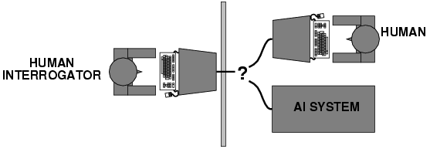
Acting humanly: Turing test
Turing (1950) "Computing machinery and intelligence“
"Can machines think?" → "Can machines behave intelligently?“
Operational test for intelligent behavior: the Imitation Game
Suggests major components required for AI:
- knowledge representation
- reasoning,
- language/image understanding,
- learning
* Question: is it important that an intelligent system act like a human?

Slide 38
Thinking humanly
Cognitive Science approach
Try to get “inside” our minds
E.g., conduct experiments with people to try to “reverse-engineer” how we reason, learning, remember, predict
Problems
Humans don’t behave rationally
e.g., insurance
The reverse engineering is very hard to do
The brain’s hardware is very different to a computer program

Slide 39
Thinking rationally
Represent facts about the world via logic
Use logical inference as a basis for reasoning about these facts
Can be a very useful approach to AI
E.g., theorem-provers
Limitations
Does not account for an agent’s uncertainty about the world
E.g., difficult to couple to vision or speech systems
Has no way to represent goals, costs, etc (important aspects of real-world environments)

Slide 40
Acting rationally
Decision theory/Economics
Set of future states of the world
Set of possible actions an agent can take
Utility = gain to an agent for each action/state pair
An agent acts rationally if it selects the action that maximizes its “utility”
Or expected utility if there is uncertainty
Emphasis is on autonomous agents that behave rationally (make the best predictions, take the best actions)
on average over time
within computational limitations (“bounded rationality”)

Slide 41
Summary of Today’s Lecture
Artificial Intelligence involves the study of:
automated recognition and understanding of signals
reasoning, planning, and decision-making
learning and adaptation
AI has made substantial progress in
recognition and learning
some planning and reasoning problems
…but many open research problems
AI Applications
improvements in hardware and algorithms => AI applications in industry, finance, medicine, and science.
Rational agent view of AI

